Slide 2
Objectives
Describe the difference between system software and application software
Provide examples of each of these
Understand the role of the operating system and utility software as system software

Slide 3


Starter
In pairs or small groups write down the names of as many items of software as you can
You have one minute

Slide 4
Starter
Some possible answers:
Linux, disk defragmenter, word processor
Windows, disk cleanup, spreadsheet software
MacOs, backup software, desktop publishing software
iOS, compression tools, social media apps
Android, antivirus, photo app

Slide 5

Software categories
Software is categorised into system software and application software
System software is further categorised into operating systems and utility software
Software
System software
Application software
Operating systems
Utility software

Slide 6

System software
System software provides the services that the computer requires
This software enables the computer or device to work, or helps to maintain the good working order of the computer
Operating systems
An operating system is responsible for important functions such as how a file is written to a hard drive or a program is loaded into RAM
Utility software
Utility software helps in configuring and maintaining the computer or device

Slide 7

Application software
Application software provides services that the user requires
Apps on smartphones and tablets get their name from application software
Application software includes:
Traditional computer software such as word-processors and spreadsheets
More modern apps such as social media apps or video players
Business software such as accountancy programs

Slide 8
Worksheet 1a
Complete Task 1 on Worksheet 1a

Slide 9
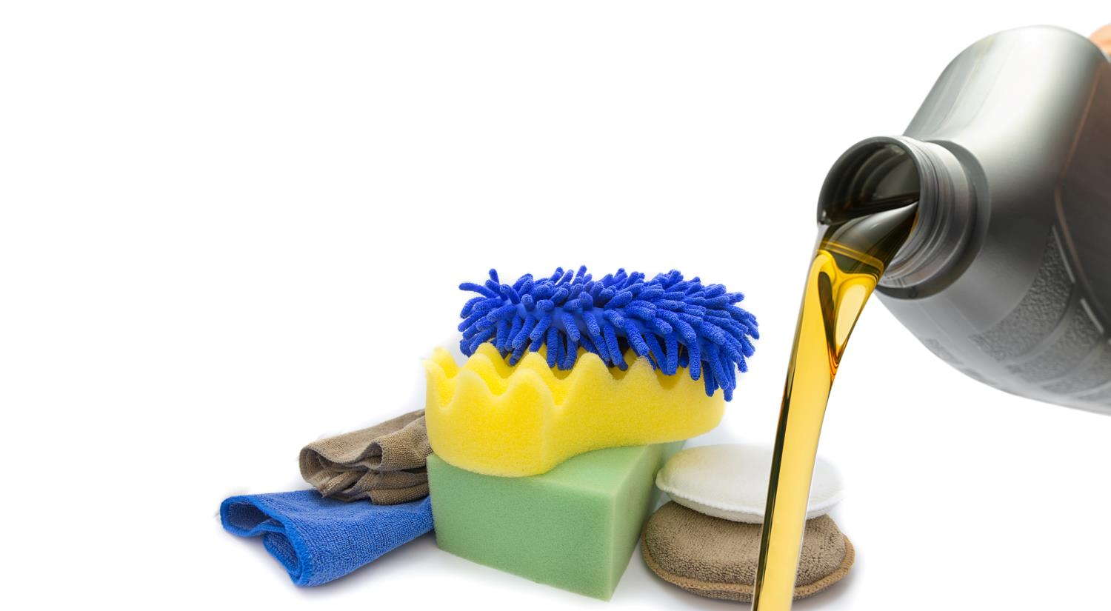
Utility software
The following are examples of utility software:
Compression tools
Backup software
Disk clean-up
Disk defragmentation
Antivirus
What do each of these do?

Slide 10
Disk defragmenter
When files are saved to a magnetic hard disk they are stored in the next available space
This can lead to files being split into fragments which take longer to access as the drive head has to move more
Defragmentation software puts each file back into one contiguous location
File A
File B
File C
File D

Slide 11
Disk clean-up
Disk drives do not need actual cleaning as they are sealed
However disk clean-up tools help to improve free space and system performance by:
Deleting temporary files
Clearing cached files for a web browser
Removing unnecessary program files

Slide 12
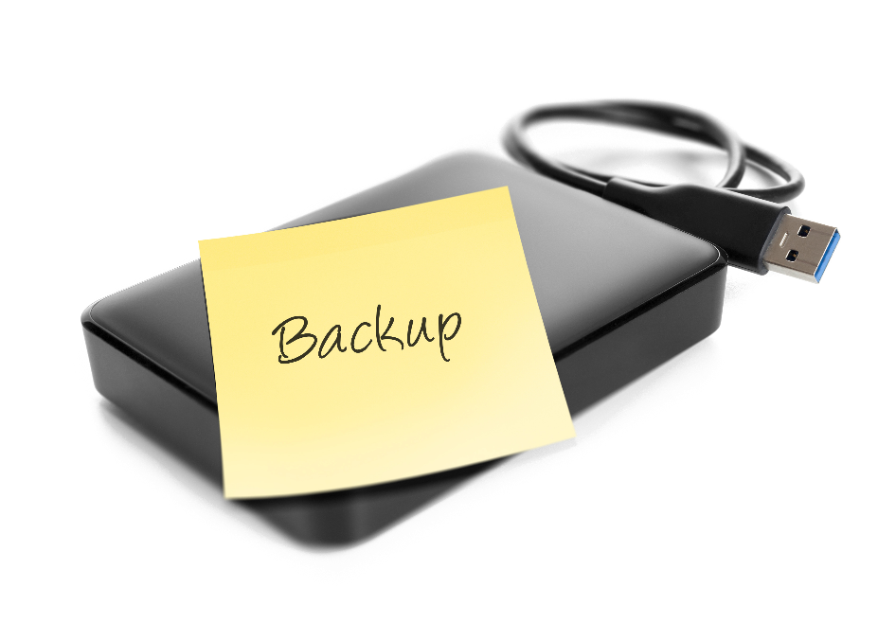
Backup and antivirus software
Hard drives sometimes fail and may also be stolen
Regular backups are made to external drives or cloud backup services
Antivirus software scans computers to make sure that they don’t contain viruses
It also scans files as they are downloaded

Slide 13
Worksheet 1b
Complete Task 2 and Task 3 on Worksheet 1b

Slide 14
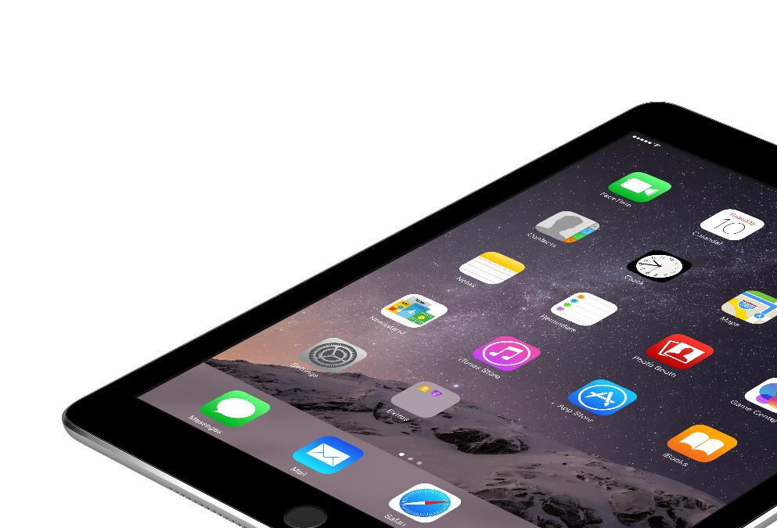
Plenary
The following is a list of software
Photo editing
iPadOS
Formatting
Regedit (changes Windows registry settings)
Video editing
For each item of software, state what type of software it is

Slide 15
Plenary
Classify the following software:
Photo editing
iPadOS
Formatting
Regedit (changes Windows registry settings)
Video editing
System software |  | Application software
Operating systems | Utility systems
iPadOS | Formatting | Photo editing
 | Regedit | Video editing

